Slide 1
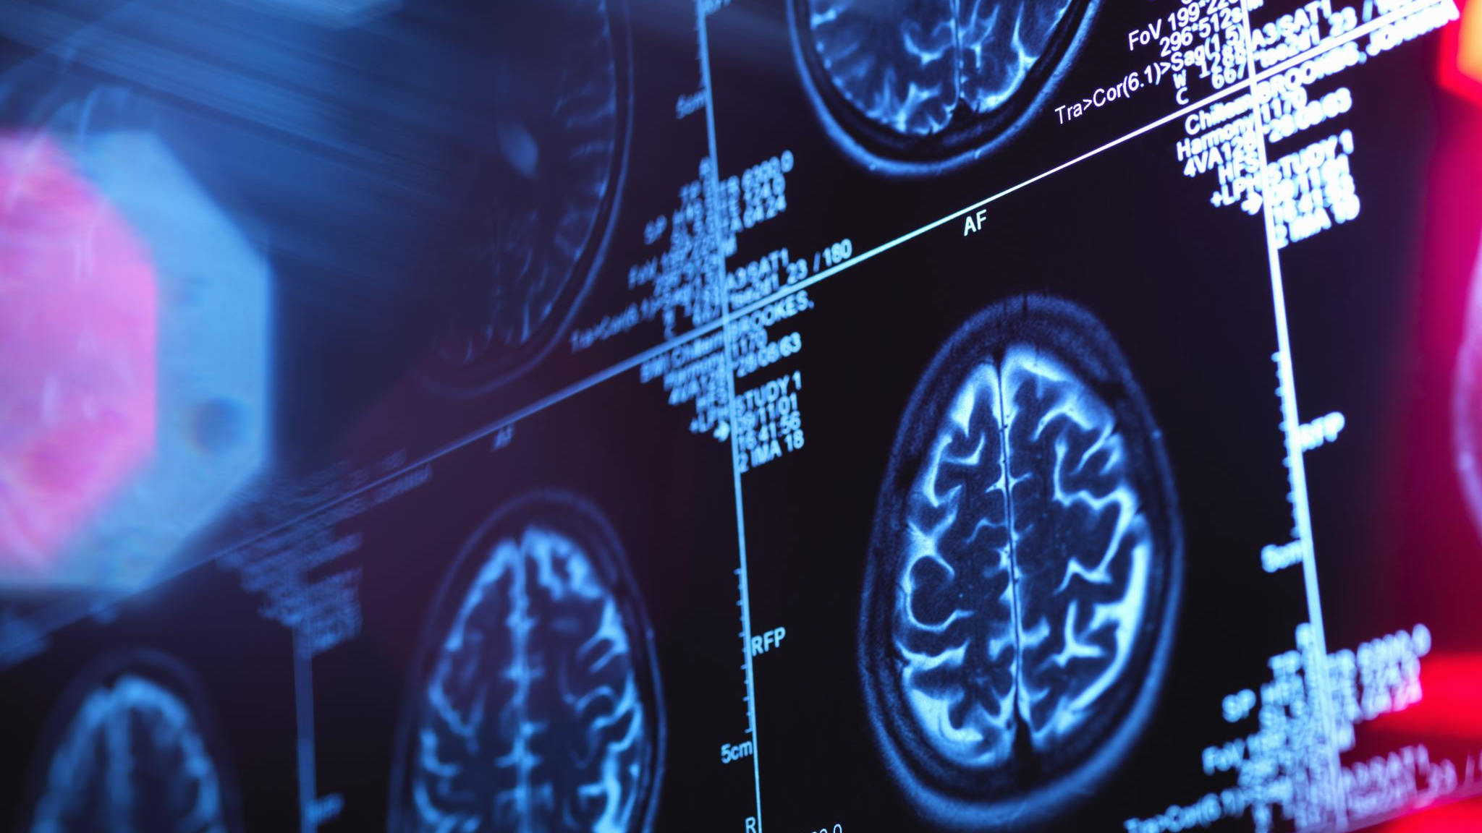
X-ray's prediction
University of Piraeus – Democritus Institute
Artificial intelligence, Master
Machine learning, Course
Theodoros Adamantidis, TN2001
Athens, February 2021

Slide 2
Content
Introduction
Feature extraction
Experiments
Results
Notes:
Με ποιο τρόπο η παρουσίαση θα ωφελήσει το ακροατήριο: Οι ενήλικες εκπαιδευόμενοι ενδιαφέρονται περισσότερο για ένα θέμα εάν γνωρίζουν με ποιο τρόπο ή γιατί αυτό είναι σημαντικό για τους ίδιους.
Το επίπεδο εξειδίκευσης του παρουσιαστή σε σχέση με το θέμα. Αναφέρετε εν συντομία τα διαπιστευτήριά σας στον τομέα ή εξηγήστε στους συμμετέχοντες γιατί πρέπει να σας ακούσουν.

Slide 3
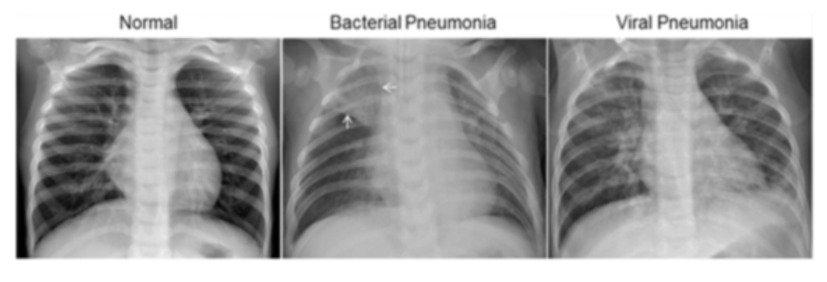
Introduction
Detect pneumonia on X-Ray images.
5,863 X-Ray images of two categories
Chest X-ray images (anterior-posterior) were selected from retrospective cohorts of pediatric patients of one to five years old from Guangzhou Women and Children’s Medical Center, Guangzhou. All chest X-ray imaging was performed as part of patients’ routine clinical care.
Notes:
Οι περιγραφές των μαθημάτων πρέπει να είναι σύντομες.

Slide 4
Feature extraction (1/3)
Corresponding notebook ExtractFeatures.ipynb in GitHub.
Developed and support 3 different types of image extraction
Plain flatten image array
KAZE descriptors array
HOG descriptors array
All images resized to 100x100 size.
Data are stored after extraction into pickle files for fast accessing in the experiments.

Slide 5
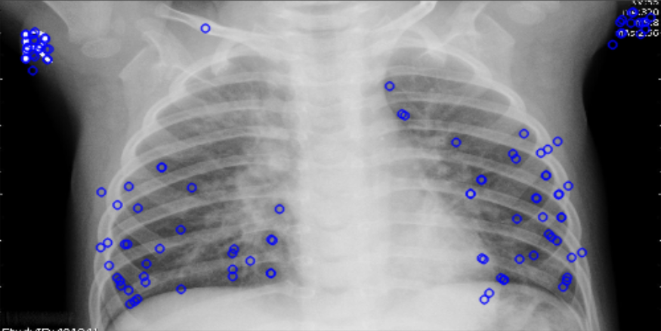
Feature extraction (2/3) - KAZE
Detect and get the first 32 key points of the image ordered by their response value.
Compute descriptor using these key points constructing a vector of 64 size.
In case of the vector is less than 64, fill it with zeros.

Slide 6
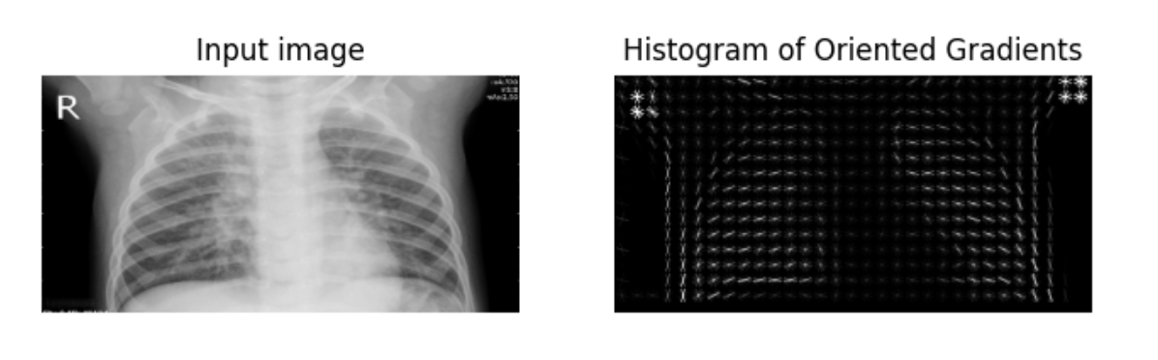
Feature extraction (3/3) - HOG
Cell size 10x10
Block size 2x2
Number of orientation bins 9
Calculates descriptor and returns the array flatten.

Slide 7
Experiments (1/7)
For the experiments used the pickle files extracted from the feature extraction step.
Standardize features.
Used to measure how “good” the model estimators are
Accuracy
Confusion matrix
Precision score
Because of the quite difference in the number of each classes data, the accuracy by it self is not a good estimator.
The models used are
Logistic regression
KNN
Discriminant analysis
Gaussian naive bayes
SVM
Used GridSearchCV with RepeatedStratifiedKFold to tune models

Slide 8
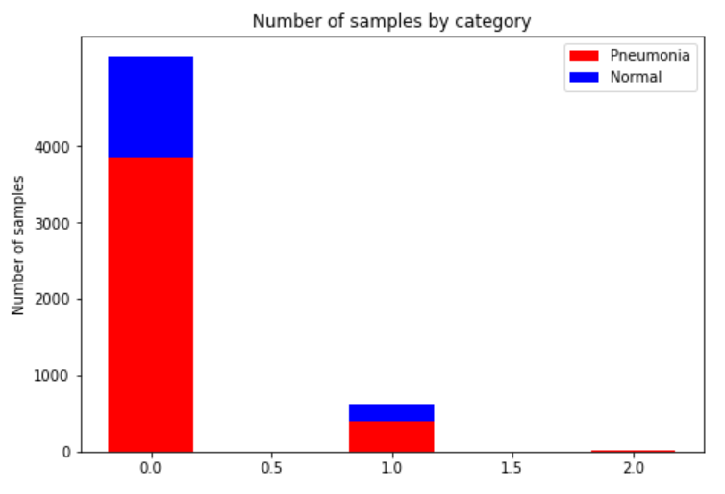
Experiments (2/7)
Number of samples in training data: 5216
Number of samples in training data where category is Pneumonia : 3875
Number of samples in training data where category is Normal: 1341
Number of samples in testing data: 624
number of samples in testing data where category is Pneumonia : 390
number of samples in testing data where category is Normal: 234
Number of samples in validate data: 16
number of samples in validate data where category is Pneumonia : 8
number of samples in validate data where category is Normal: 8

Slide 9
Experiments (3/7) – Logistic regression
No tuned
Accuracy LR classifier on training set: 1.00
Accuracy of LR classifier on test set: 0.80
Accuracy of LR classifier on validate set: 0.50
Precision score 0.7661290322580645
Tuned (C = 0.01)
Accuracy LR classifier on training set: 1.00
Accuracy of LR classifier on test set: 0.80
Accuracy of LR classifier on validate set: 0.50
Precision score 0.768762677484787
Pred/Label | Normal | Pneumonia
Normal | 118 | 116
Pneumonia | 10 | 380
Pred/Label | Normal | Pneumonia
Normal | 120 | 114
Pneumonia | 11 | 379

Slide 10
Experiments (4/7) – KNN
No tuned
Accuracy of K-NN classifier on training set: 0.96
Accuracy of K-NN classifier on test set: 0.81
Accuracy of K-NN classifier on validate set: 0.50
Precision score 0.8096330275229358
Tuned (neighbors = 11, weight = ‘distance’, alg = kd_tree)
Accuracy of K-NN classifier on training set: 1.00
Accuracy of K-NN classifier on test set: 0.82
Accuracy of K-NN classifier on validate set: 0.50
Precision score 0.768762677484787
Pred/Label | Normal | Pneumonia
Normal | 151 | 83
Pneumonia | 37 | 353
Pred/Label | Normal | Pneumonia
Normal | 158 | 76
Pneumonia | 37 | 353

Slide 11
Experiments (5/7) – Discriminant analysis
No tuned
Accuracy of LDA classifier on training set: 1.00
Accuracy of LDA classifier on test set: 0.79
Accuracy of LDA classifier on validate set: 0.50
Precision score 0.766260162601626
Tuned (solver = ‘lsqr’)
Accuracy of LDA classifier on training set: 1.00
Accuracy of LDA classifier on test set: 0.79
Accuracy of LDA classifier on validate set: 0.50
Precision score 0.7676348547717843
Pred/Label | Normal | Pneumonia
Normal | 119 | 115
Pneumonia | 13 | 377
Pred/Label | Normal | Pneumonia
Normal | 122 | 112
Pneumonia | 20 | 370

Slide 12
Experiments (6/7) – Gaussian naive bayes
Accuracy of GNB classifier on training set: 0.89
Accuracy of GNB classifier on test set: 0.76
Accuracy of GNB classifier on validate set: 0.50
Precision score 0.780373831775701
Pred/Label | Normal | Pneumonia
Normal | 140 | 94
Pneumonia | 56 | 334

Slide 13
Experiments (7/7) – SVM
No tuned
Accuracy of SVM classifier on training set: 1.00
Accuracy of SVM classifier on test set: 0.79
Accuracy of SVM classifier on validate set: 0.50
Precision score 0.7589641434262948
Tuned (C = 100, kernel = ‘Linear’)
Accuracy of SVM classifier on training set: 1.00
Accuracy of SVM classifier on test set: 0.80
Accuracy of SVM classifier on validate set: 0.50
Precision score 0.7703252032520326
Pred/Label | Normal | Pneumonia
Normal | 113 | 121
Pneumonia | 9 | 381
Pred/Label | Normal | Pneumonia
Normal | 121 | 113
Pneumonia | 11 | 379

Slide 14
Results
Model:: Logistic regression achieved:: 0.7661290322580645 precision score.
Model:: Logistic regression tuned achieved:: 0.768762677484787 precision score.
Model:: KNN achieved:: 0.8096330275229358 precision score.
Model:: KNN tuned achieved:: 0.8228438228438228 precision score.
Model:: Discriminant analysis achieved:: 0.7676348547717843 precision score.
Model:: Discriminant analysis tuned achieved:: 0.766260162601626 precision score.
Model:: Gaussian naive bayes achieved:: 0.780373831775701 precision score.
Model:: SVM achieved:: 0.7589641434262948 precision score.
Model:: SVM tuned achieved:: 0.7703252032520326 precision score.

